Slide 1
Ministry of Science and Higher Education of the Russian Federation
Federal State Autonomous Educational Institution of Higher Education
TOMSK STATE UNIVERSITY OF CONTROL SYSTEMS AND RADIOELECTRONICS (TUSUR)
Department of Automated Control Systems (ACS)
C# as a Game Development Language
Completed by: student of group 435-M1 Andreev Dmitry
Supervisor : Senior Lecturer, Department of Foreign Languages
Tereshchenko Anna
Tomsk 2026

Slide 2


Content
Introduction
How C# Became a Game Language
Why C# Is So Good
C# Becomes Faster
Conclusion
Bibliography

Slide 3

Introduction
C# is one of the most popular languages for making games today.
It started as a tool for business apps, but quickly became the main language for Unity — the world's most used game engine.

Slide 4
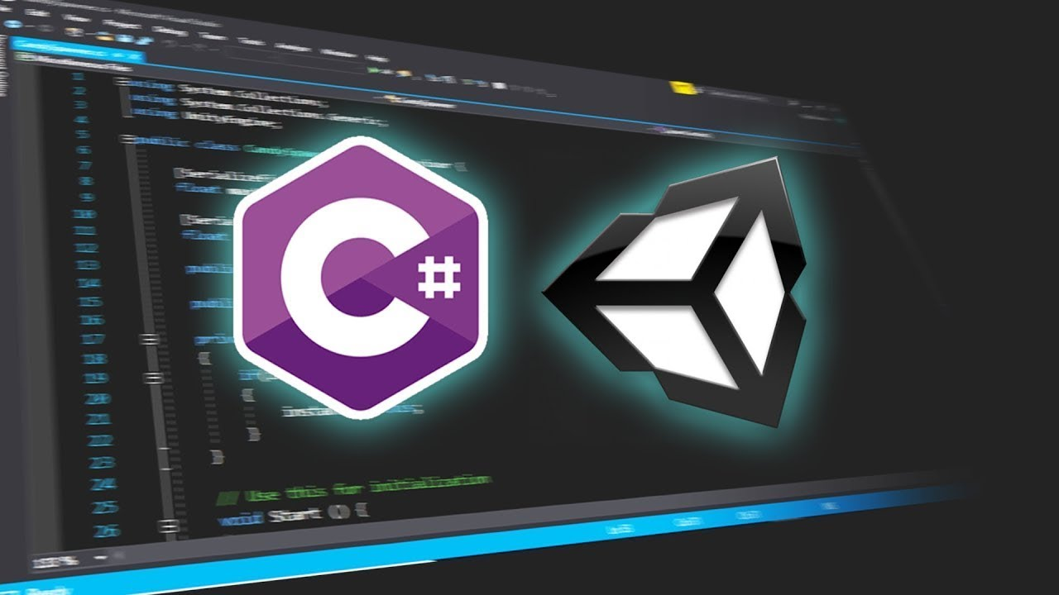
How C# Became a Game Language
Microsoft created C# in 2000 for Windows apps.
For a few years, nobody used it for games. Then in 2005, Unity came out and chose C# as its main scripting language.
That changed everything. Unity made game development easy, and C# made it understandable.

Slide 5

Why C# Is So Good
C# is easy to read and write. It has clean syntax and automatic memory management.
It is a great balance: not too hard like C++, not too slow like Python. It just works.

Slide 6

C# Becomes Faster
People used to say C# was too slow for big games with thousands of enemies. Unity fixed this with DOTS. DOTS allows C# to use all CPU cores at once, which makes it much faster.
It also has a Burst Compiler that turns C# code into super-fast machine code.

Slide 7

Conclusion
C# is not just a language. It is a gateway to game development. If you dream of making games, C# is your best first step.

Slide 8
Bibliography
1) Modern C# for Beginners and Junior Developers. [Electronic resource]. Habr. URL: https://habr.com/ru/articles/983416/.
2) C# is a modern, open-source programming language. [Electronic resource]. Microsoft. URL: https://dotnet.microsoft.com/ru-ru/languages/csharp.
3) C# Scripting Basics in Unity for Beginners. [Electronic resource]. Xrayisgray.
URL: https://xrayisgray.de/tutorials/csharp-intro.ru.html.
4) Unity: Develop, deploy, and grow | The world’s leading game engine. [Electronic resource]. Uniti. URL: https://unity.com/ru.
5) Game Development in Unity: Where to Start? [Electronic resource]. Habr. URL: https://habr.com/ru/articles/828302/
6) C Sharp — Wikipedia. [Electronic resource]. Wikipedia. URL: https://ru.wikipedia.org/wiki/C_Sharp
7) The History of Programming Languages: C# — Leading the Way. [Electronic resource]. Habr. URL: https://habr.com/ru/articles/313694/

